Slide 1




From Bills to Jobs: How the Green Transition Touches Us All

Slide 2
What is the first thing that comes to your mind when you hear the words “green economy”?

Slide 3
What worries you most about this topic?

Slide 4
What does the green economy include?

Slide 5
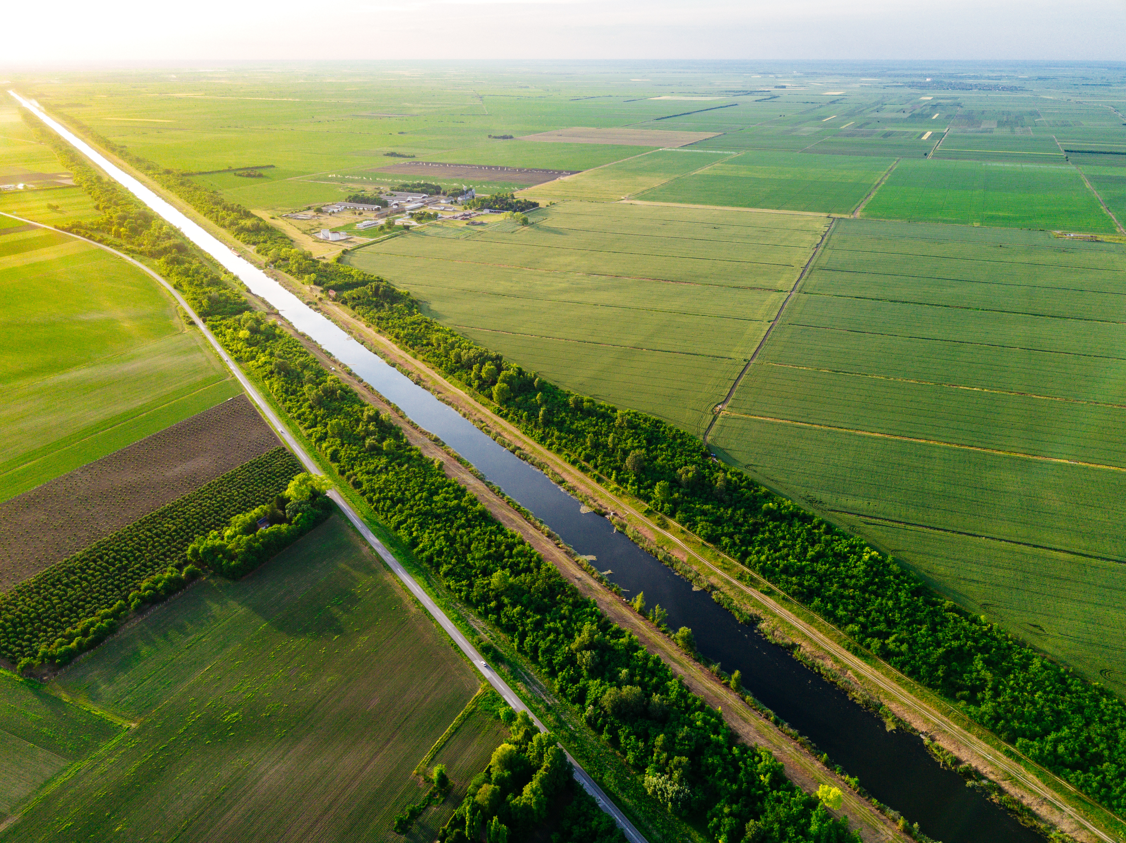
“...an economy that improves people’s lives and creates jobs, while protecting natural resources and the environment.”

Slide 6

...helps us live well without wasting energy, money, or nature.

Slide 7
Energy in our homes
1
Transport and mobility
2
Food and agruculture
3
Materials and waste
4
Nature and wellbeing
5

Slide 8
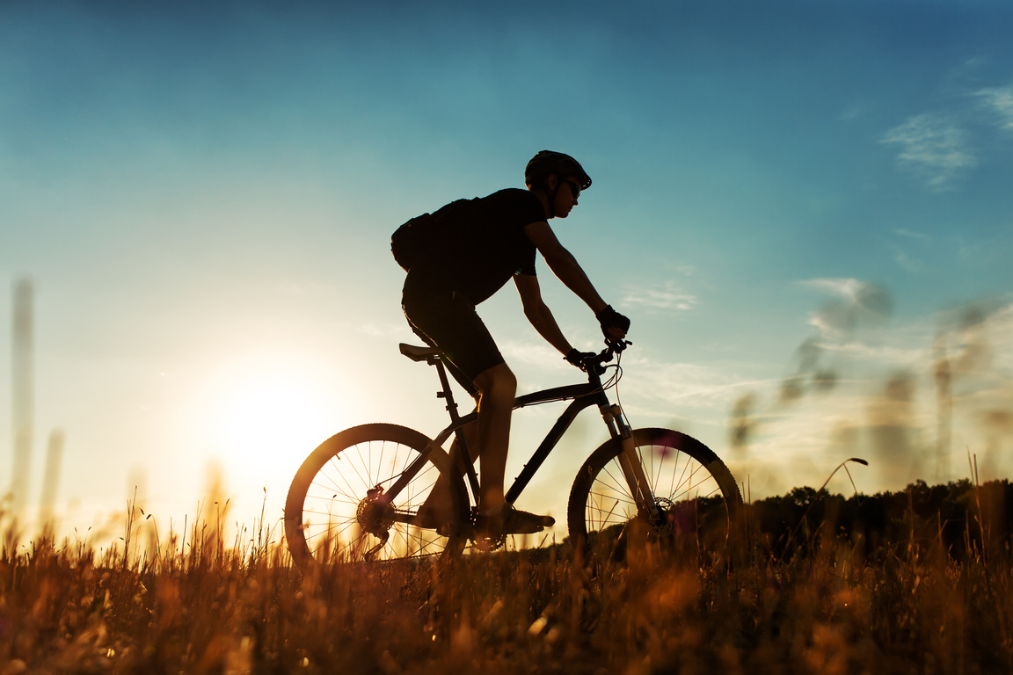
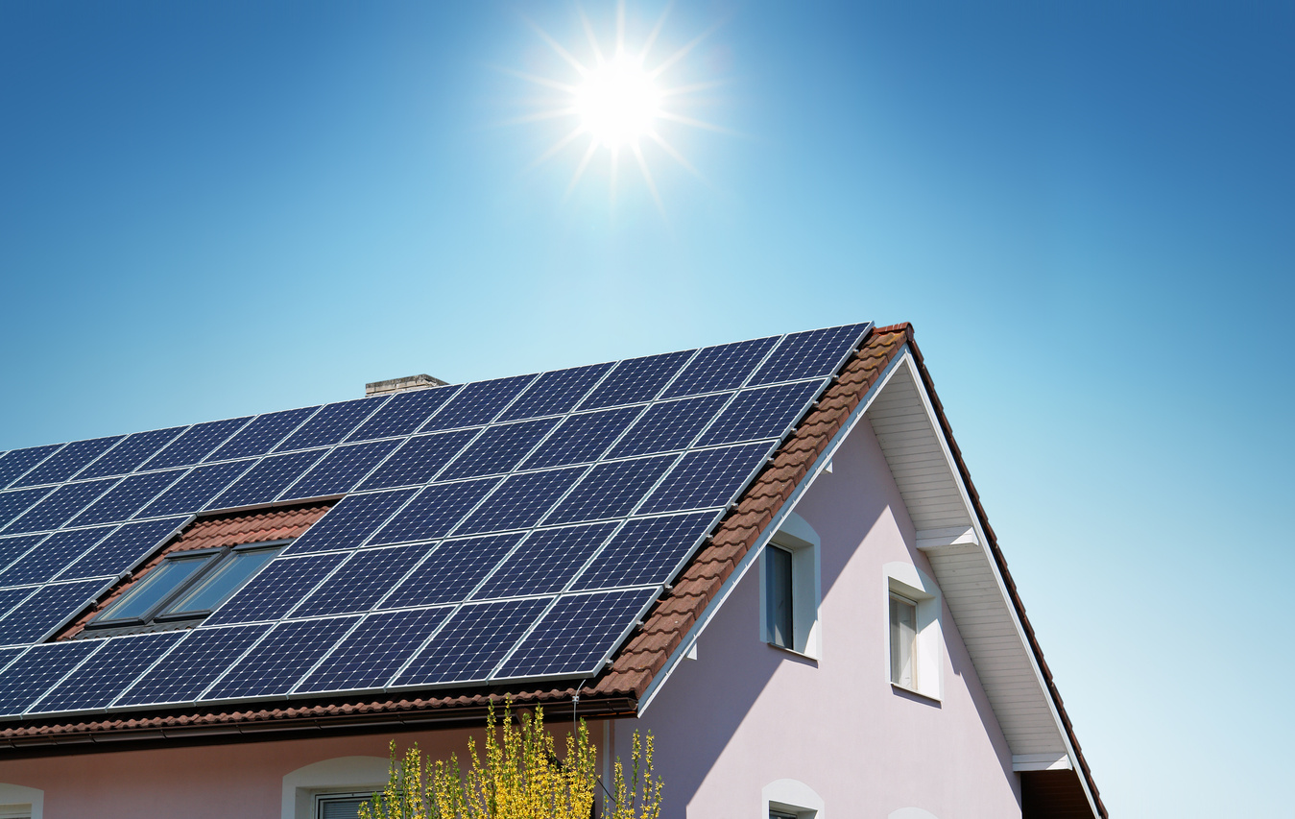
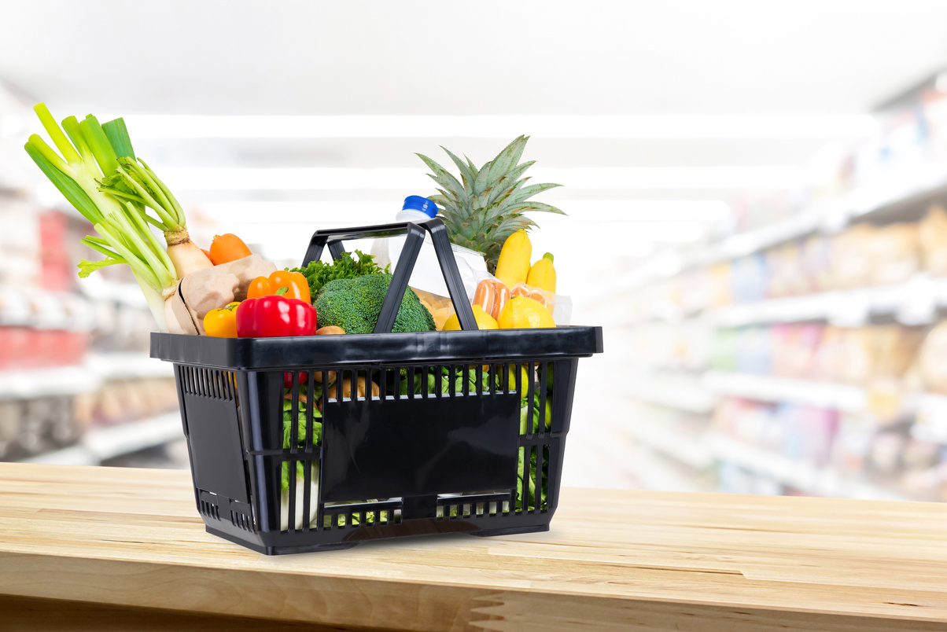
Quizz
A bycicle
A solar panel on the roof
A supermarket throwing away unsold food

Slide 9

How does this affect my job, my wallet, and my everyday life?

Slide 10
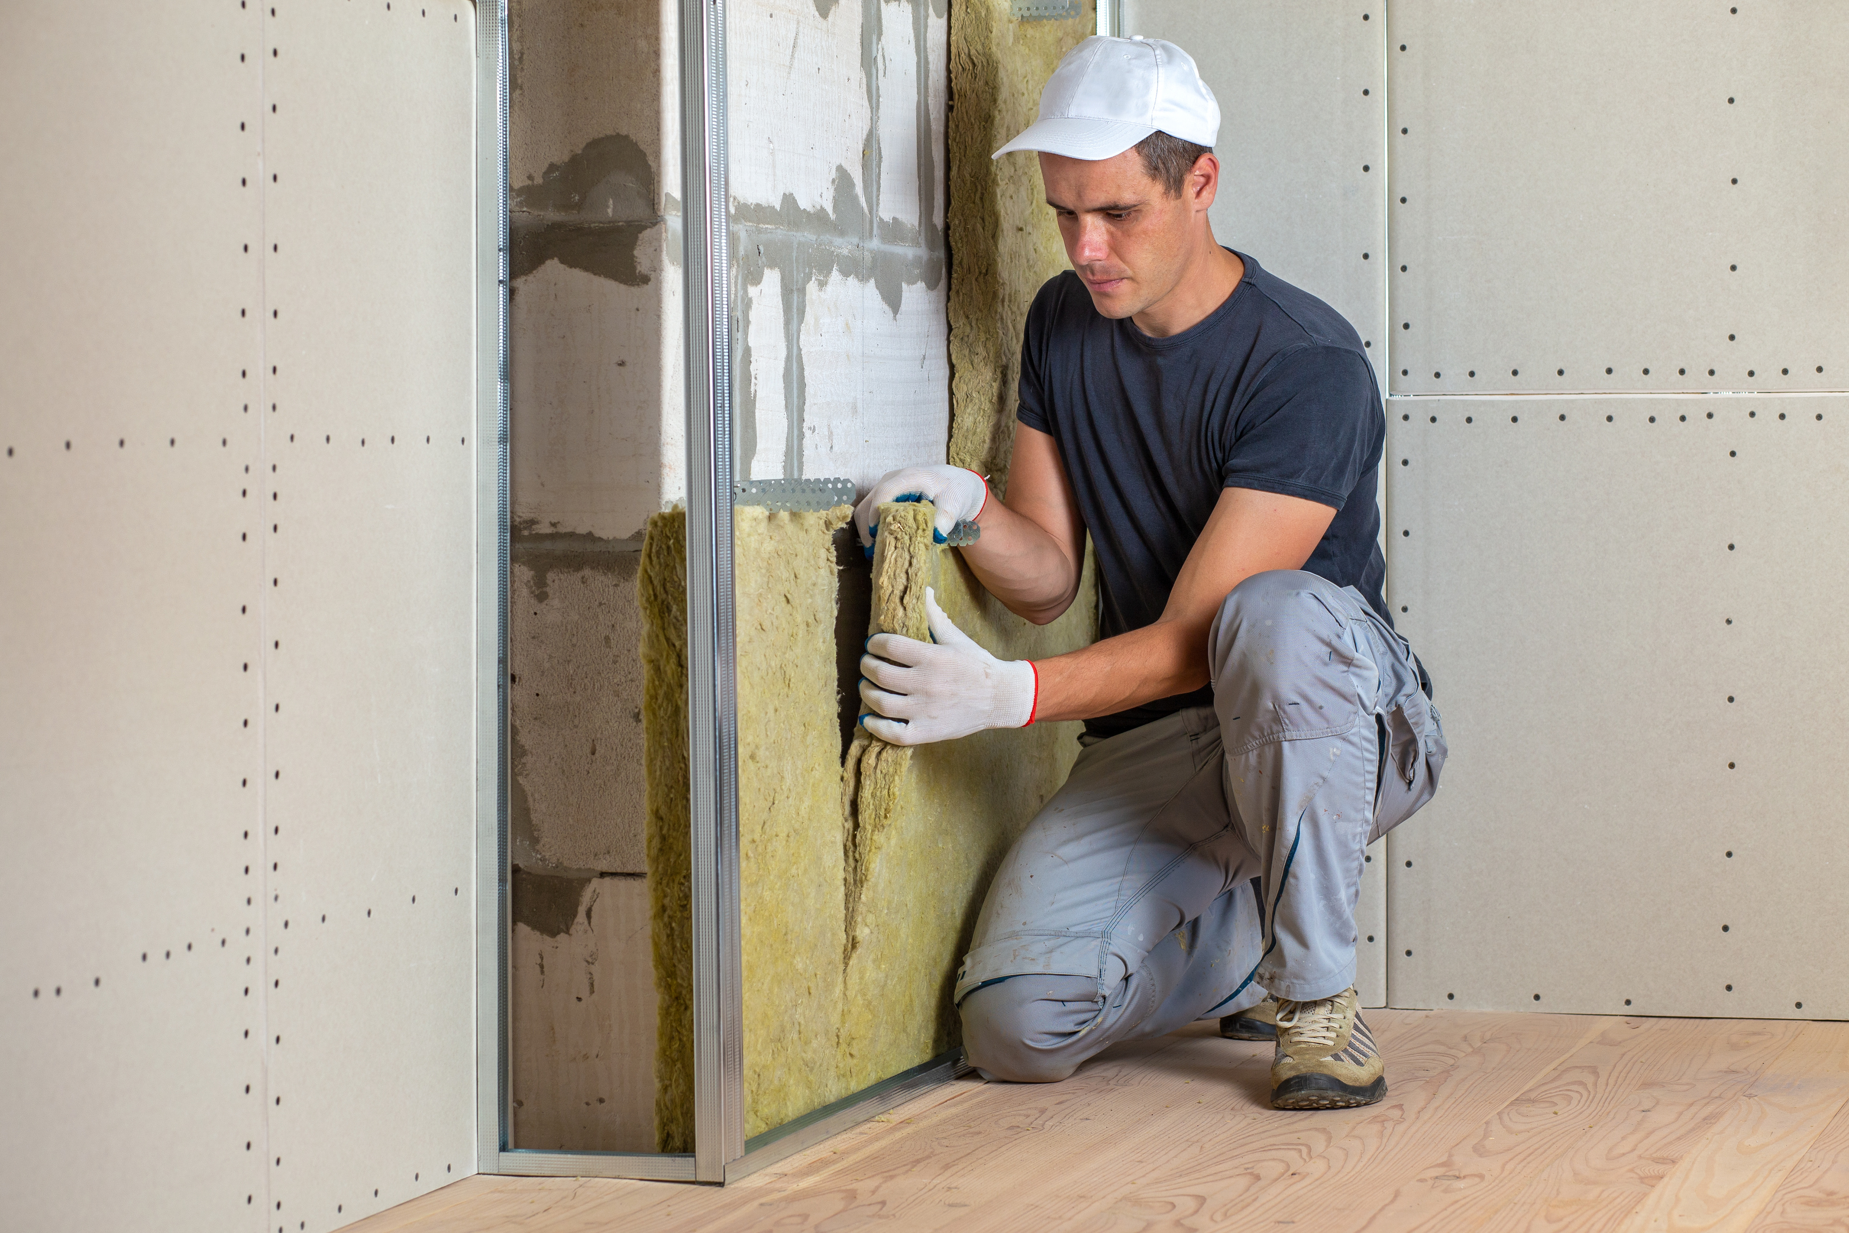
Jobs and work opportunities

Slide 11
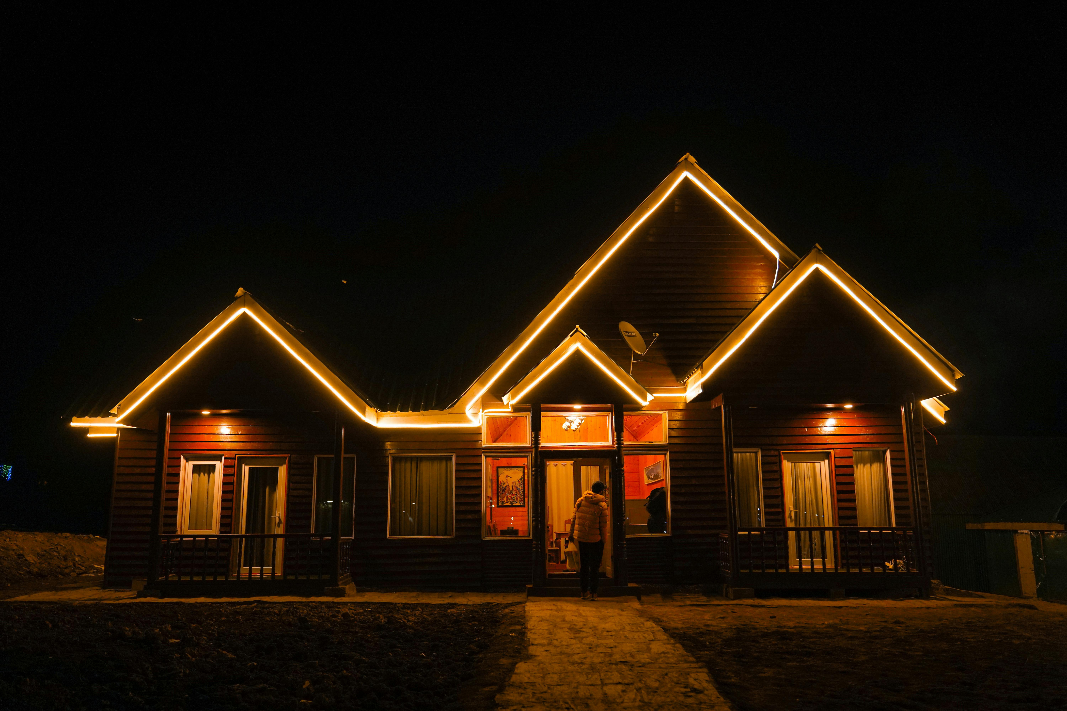
Costs and housholds budgets

Slide 12

Qualitiy of life and wellbeing

Slide 13
The European Green Deal
in simple words

Slide 14
Food and farming
Waste and recycling
Energy
Transport
Buildings

Slide 15
How much household waste does an average European produce every year?

Slide 16
500 kg
like carrying 7 adults on your shoulders

Slide 17
How many new jobs could be created every year by renovations of buildings?

Slide 18
up to 160.000

Slide 19
How many premature deaths are caused by air pollution per year in the EU?

Slide 20
over 300.000

Slide 21
If you could choose one area for your town to improve first - energy, transport, food or waste - which would you pick?

Slide 22
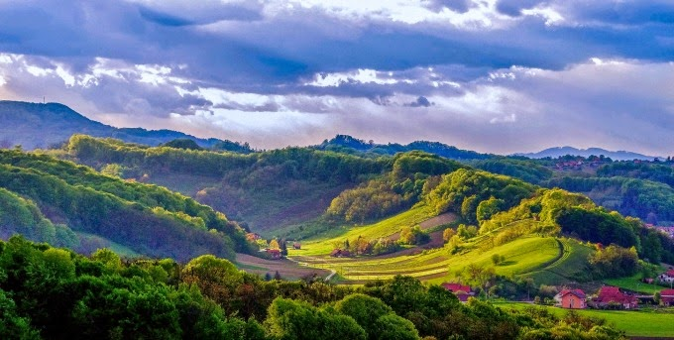
Stories from Zagorje.........

Slide 23

Energy efficiency in public buildings
1
Children have better classrooms
2
Municipalities save money on energy bills
3
Local construction companies get the jobs

Slide 24
Solar energy and renewables
1
Energy community in Špičkovina
2
Geothermal energy
3
Solar energy in households

Slide 25
Local business & green innovation
1
Modernizing production facilities
2
Startups developing green and digital solutions
3
Farmers using solutions supporting sustainable agriculture

Slide 26
Citizens & everyday life
1
Charging stations for electric cars
2
Recycling bins
3
Local food markets

Slide 27
What about you?

Slide 28


Slide 29
True or False
From the year 2035, new petrol and diesel cars will no longer be sold in the European Union.

Slide 30
How much household waste does an average European produce each year?
A
100 kg
350 kg
B
C
500 kg

Slide 31
Which of these saves the most energy in your home?
A
Switching off lights when you leave the room
B
Replacing old windows with insulated ones
C
Using the washing machine at night

Slide 32
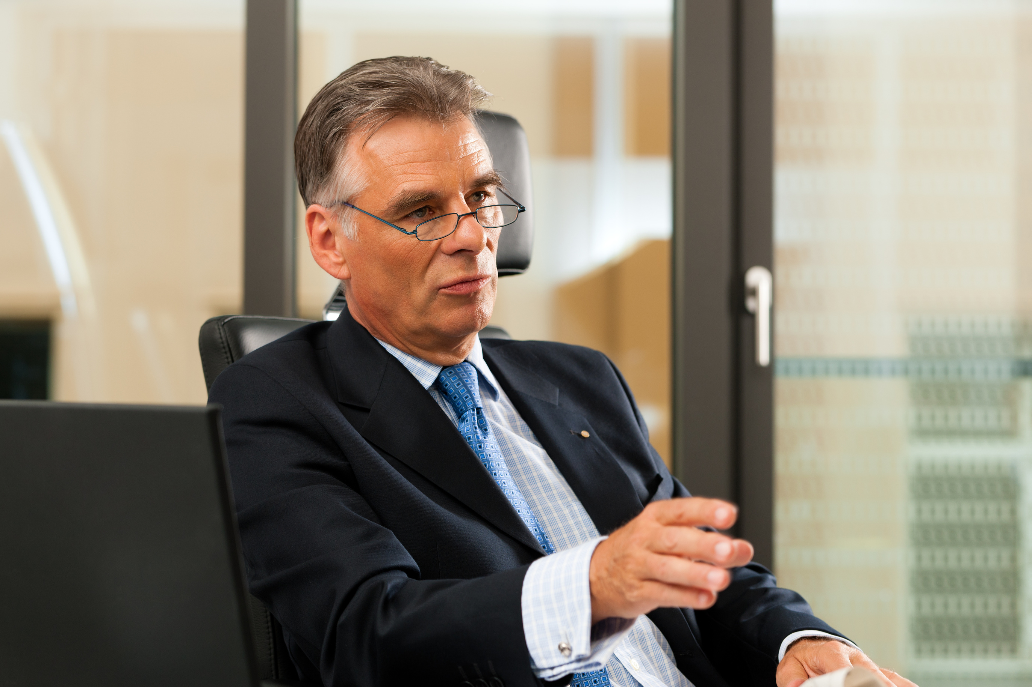
If you could choose one green action for your community, what would it be?

Slide 33
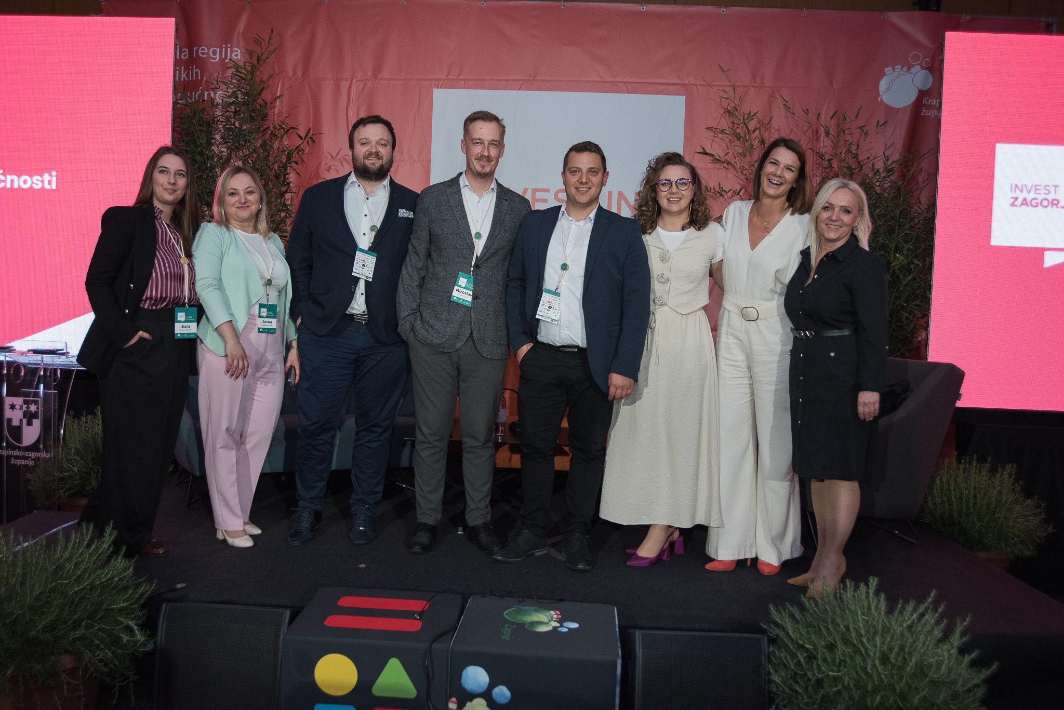
Thank you!
Entrepreneurship Centre of Krapina Zagorje County
Helena Matuša, helena@pckzz.hr

